Slide 1
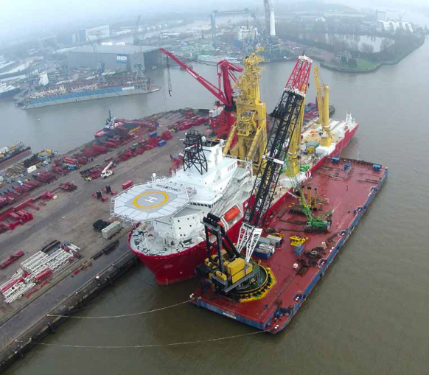
The Netherlands’ Maritime Strategy 2015 - 2025
Brigit Gijsbers
Director for Maritime Affairs

Slide 2
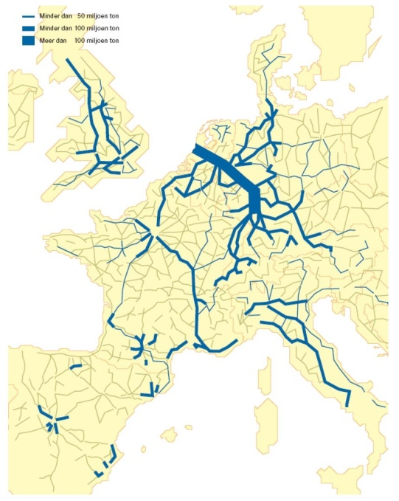
The Netherlands: a maritime nation
Main goods flows withing Europe
Strategic geographical location
Rotterdam ‘gateway’ to Europe
Maritime cluster strong international position and vital for Netherlands’ economy:
  Value added: € 24 bln
  (3.5 % of GNP)
  Employment: 265.000
  (3 % of national employment)
  Export: € 24.4 bln
Notes:
As a trading nation, the Netherlands has succeeded in building up a strong global maritime position, partly as a result of the strategic location at the estuary of the rivers Meuse, Rhine and Scheldt.
Rotterdam is regarded as ‘gateway’ to Europe and as Europe’s largest port, it serves a hinterland with hundreds of millions of inhabitants.
The Dutch maritime cluster is active on all continents and of vital importance for the Dutch economy (-> next sheet).
This becomes clear when we look at the following figures (-> sheet)

Slide 3
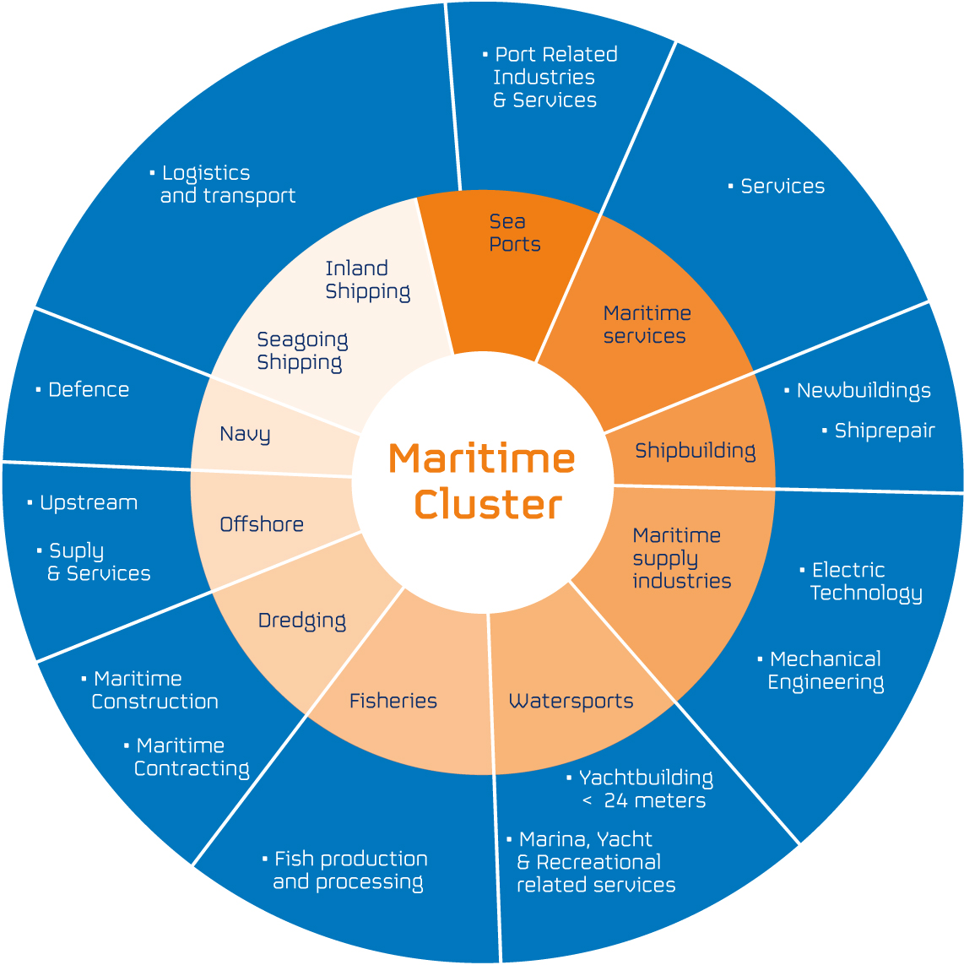
Notes:
This is a figure of the Dutch Maritime Cluster.
As you can see from the inner circle it represents all relevant maritime sectors, such as Ports, Shipbuilding, Seagoing Shipping but also Inland Shipping and even the Dutch Royal Navy.
The outer circle represents the business areas to which the maritime sectors relate.

Slide 4
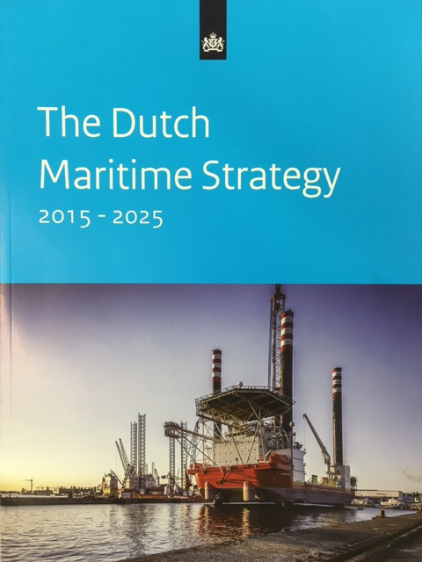

Reason for Maritime Strategy
Strong position cannot be taken for granted
Overall strategic approach needed
Netherlands’ Maritime Strategy 2015 - 2025
Notes:
The question is how to take advantage of this situation because the strong international position of the maritime cluster cannot be taken for granted.
There are several trends and developments worldwide that can influence the maritime cluster. Structural
economical, demographical, ecological and security policy changes affect the maritime cluster to a greater
or lesser extent.This changing world presents challenges and opportunities for the cluster such as access to new markets and trading partners. However, there are also threats and risks and the competition is not going to wait for us to catch up.
So additional efforts are needed to maintain and strengthen the contribution of the maritime cluster to our national economic and social interests.
From our point of view this this requires a government-wide performance and intensified cooperation between the national government and the relevant parties
from the maritime cluster. This will lead to a mutual reinforcement of public and private interests.
This way of thinking has led to the Dutch Maritime Strategy 2015 – 2025, which provides a comprehensive framework for the government-wide policy for the maritime cluster.
It has been established in close cooperation with the maritime cluster and reveals the main challenges for the maritime policy for the coming years and how the government and the maritime cluster will each contribute to it.
Let’s take a closer look at the strategy.

Slide 5
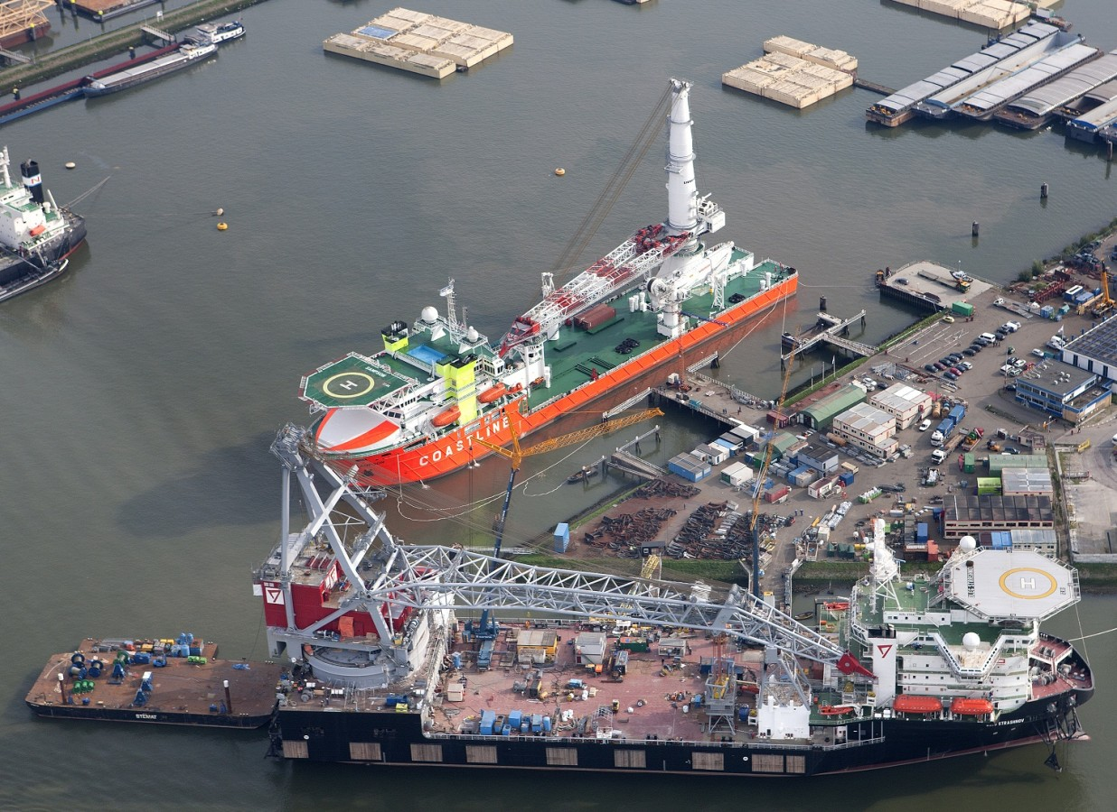
Six Cluster-wide Policy Areas
Human Capital
Innovation
Trade
Accessibility
Safety and Environment
Security Threats and Stability
Notes:
To strengthen the maritime interests of the Netherlands, the policy has a focus on areas that are relevant to the entire maritime cluster.
These unifying areas enable knowledge, experience, best practices and innovations to be shared cluster-wide, and solutions that contribute to the strengthening of the maritime cluster as a whole can be found.
After all, it makes no sense to find solutions for the separate industries if the outcome is less than optimal for the maritime cluster as a whole.
Unifying policy areas that are the focus of the maritime strategy are: -> sheet. We have program’s which contain actions in these area’s for sea shipping, inland shipping, ports and the maritime manufacturing industry. The maritime strategy identifies policy actions among other things to:
Human Capital: encourage young people to choose for a maritime profession
Innovation: support innovation by removing legal barriers and provide room for experimentation
Trade: ensure a level playing field
Accessibility: integrate maritime transport in the logistic chain
Safety and Environment: reduce emissions by shipping and in ports
Security Threats and Stability: exchange information and support cooperation between civil and military actors
How do we deal with these policy areas?

Slide 6
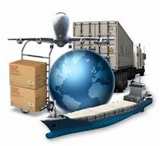

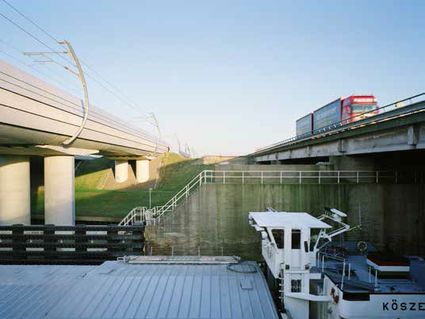
Maritime Strategy focus
General social trends and developments
Public and private cooperation
Notes:
In dealing with the six Cluster-wide Policy Areas our focus is on two points:
1. General social trends and developments
For the cluster-wide areas, the maritime strategy wants to align with the general social trends and developments.
This means that the maritime strategy will opt for solutions that are in line with these trends and developments.
2. Public and private cooperation
Challenges in maritime core areas such as employment, innovation, trade, logistics, safety and environment are becoming increasingly complex. Regarding these areas, both public and private interests are at stake.
This means that the government and the maritime cluster need each other to be successful. Cooperation is a prerequisite for success. Therefore the maritime strategy gives public and private cooperation a central role.
Let’s first take a look at the general social trends and developments the maritime strategy wants to align with.

Slide 7
Policy objectives
From | To
Separate industry solutions | Cluster-wide solutions
Generic solutions according to offer | Customized solutions according to demand
Expanding infrastructure | Construction and better utilization
Separate mode of transport | Logistical chain/Cargo flows
Physical flows | Information flows
Incidental solutions | Sustainable solutions
Notes:
Maritime policy is made within the context of society as a whole.
Therefore our maritime strategy will opt for solutions that are in line with the development directions as mentioned on the slide as much as possible.
-> sheet
Let’s now look at our second focal point: public and private cooperation

Slide 8


Public - private cooperation
Structural dialogue
Cooperation successful
Priorities and co-production
Notes:
For the implementation of the maritime strategy we have established a structural dialogue between the relevant ministries and the maritime cluster in the form of regular consultations and maritime conferences.
For example: last month we organized a maritime conference with -in total- more than two hundred participants from the government and the maritime cluster with the intention to set priorities and goals for the coming years. This process of working together, sharing knowledge and information is considered valuable by all parties involved and makes it possible to review and, if necessary, amend our ambitions at an early stage.
This way of working has also led to an early communication on maritime matters inside the government between the involved departments. That is important because often more than one department is involved in a specific maritime file. Sharing information and consulting each other in an early stage has therefore led to more harmonized and government-wide solutions.
Nevertheless the implementation of the maritime strategy remains a challenging process, because each private party has also own priorities and the working capacity is not infinite.
For this reason we emphasise the need of setting priorities and co-production whereas the national government expects large commitment and own responsibility from the private parties

Slide 9

Actual situation
Making good progress
  Business climate
  Nautical services
  Trade missions
Still many challenges ahead!
Notes:
What is the actual situation two years after the Dutch Parlement gave the strategy a green light?
We are making good progress. Many actions haven been taken and will lead to results in the foreseeable future.
For instance actions that will lead to:
A favourable business climate.
The national government and the shipping industry are working closely together to organize a more efficient registry and certification of sea going vessels so that the quality is comparable to that of other important shipping registers.
Modernisation of nautical services.
In the area of nautical services, the government, in cooperation with the industry, intends to offer more room for innovation and customization. The government stimulates the innovation by acting as a launching customer (governmental vessels/Royal Navy) and removing legal barriers as much as possible. For example: within the context of Smart Shipping we are experimenting with Autonomous Shipping.
Trade missions
International opportunities for the maritime cluster are enlarged by more prominent involvement of the maritime cluster in trade missions. And also the Royal Dutch Navy contributes to the promotion of the maritime cluster by fleet visits.
Two years maritime strategy has learned that the implemention is a dynamic proces and that is necessary to readjust our priorities on a regular basis. There are many challenges ahead!
Thank you.

