Slide 1

REGIONAL INTIATIVES FOR SUSTAINABLE USE OF THE AFRICAN OCEANS AND SEAS
Ndiaga Gueye Regional Senior Fisheries and Aquaculture Officer (FAO-RAF)
Secretary of CECAF and CIFAA

Slide 2
FAO MANDATE
REGIONAL INTIATIVES FOR SUSTAINABLE USE OF THE AFRICAN OCEANS AND SEAS | Ndiaga Gueye, FAORAF
FAO three main goals are:
the eradication of hunger, food insecurity and malnutrition;
the elimination of poverty and the driving forward of economic and social progress for all; and,
the sustainable management and utilization of natural resources, including land, water, air, climate and genetic resources for the benefit of present and future generations.

Slide 3
ONE OF OUR STRATEGIC OBJECTIVES
REGIONAL INTIATIVES FOR SUSTAINABLE USE OF THE AFRICAN OCEANS AND SEAS | Ndiaga Gueye, FAORAF
Make agriculture, forestry and fisheries more productive and sustainable
Source: www.un.org

Slide 4

Overview of the presentation
REGIONAL INTIATIVES FOR SUSTAINABLE USE OF THE AFRICAN OCEANS AND SEAS | Ndiaga Gueye, FAORAF
Fishery and food security
The international fisheries management framework
Introducing the Regional Fisheries Bodies & Management organizations
Focus on the Africa Region / CECAF
  Key Facts
  Main Challenges
  Ways Forward

Slide 5
REGIONAL INTIATIVES FOR SUSTAINABLE USE OF THE AFRICAN OCEANS AND SEAS | Ndiaga Gueye, FAORAF
SOFIA 2016

Slide 6
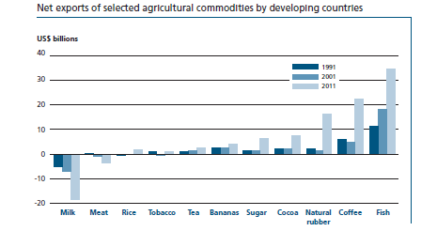
Socio economic importance of fish and seafood
REGIONAL INTIATIVES FOR SUSTAINABLE USE OF THE AFRICAN OCEANS AND SEAS | Ndiaga Gueye, FAORAF
The fishery sector is dependent on healthy aquatic ecosystems

Slide 7
Fish as food
REGIONAL INTIATIVES FOR SUSTAINABLE USE OF THE AFRICAN OCEANS AND SEAS | Ndiaga Gueye, FAORAF
Important source of animal protein
Fish provides significant micro-nutrients, minerals and essential fatty acids
A critical safety net for vulnerable households
Source: Word Wildlife Fund

Slide 8
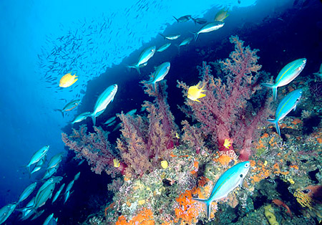
REGIONAL INTIATIVES FOR SUSTAINABLE USE OF THE AFRICAN OCEANS AND SEAS | Ndiaga Gueye, FAORAF
Fishery is the last major food-producing sector directly harvesting natural resources
The fishery sector is dependent on healthy aquatic ecosystems

Slide 9
Fisheries Management
REGIONAL INTIATIVES FOR SUSTAINABLE USE OF THE AFRICAN OCEANS AND SEAS | Ndiaga Gueye, FAORAF
The integrated process of information gathering, analysis, planning, consultation, decision-making, allocation of resources and formulation and implementation, with enforcement as necessary, of regulations or rules which govern fisheries activities in order to ensure the continued productivity of the resources and the accomplishment of other fishery objectives

Slide 10
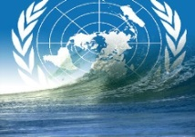
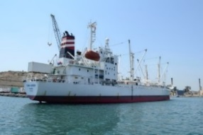



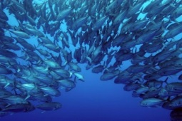
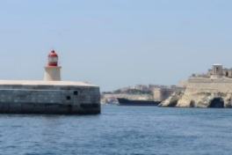

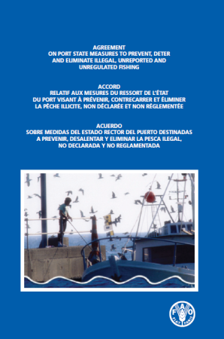
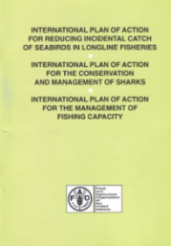
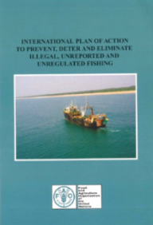
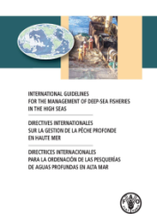
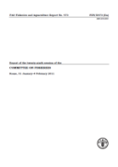
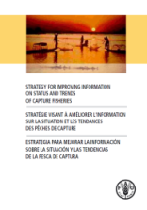
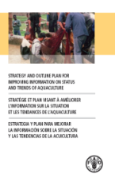
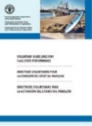
International Instruments for fisheries conservation, management and governance
REGIONAL INTIATIVES FOR SUSTAINABLE USE OF THE AFRICAN OCEANS AND SEAS | Ndiaga Gueye, FAORAF
UNCLOS (1982)
FAO Compliance Agreement (1993)
FAO Code of Conduct for
Responsible Fisheries (1995)
UN Fish Stocks Agreement (1995)
FAO Port State Measures
Agreement (2009)
International Plans of Action
Sharks, Seabirds, Capacity, IUU
(1999-2001)
International Guidelines
FSP, SSF, BC/DC, DSF
(2009-2014)
Strategies on information
STF, STA
(2003-2008)

Slide 11
Major instruments and Processes: Fisheries
REGIONAL INTIATIVES FOR SUSTAINABLE USE OF THE AFRICAN OCEANS AND SEAS | Ndiaga Gueye, FAORAF
Binding
UNCLOS
UNFSA
Compliance Agreement
Port State Measures Agreement
CBD
CITES
Non-Binding
UNGA resolutions
Code of Conduct
IPOAs
Guidelines on Flag state performance
Deep-sea Guidelines
Bycatch Guidelines

Slide 12
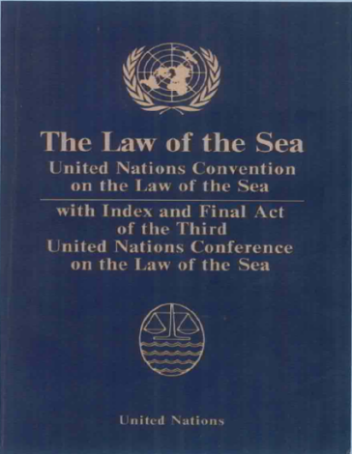
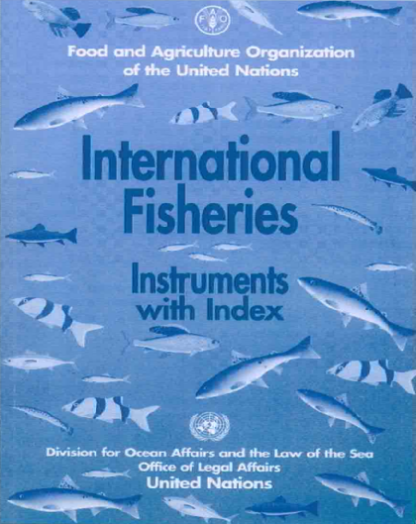
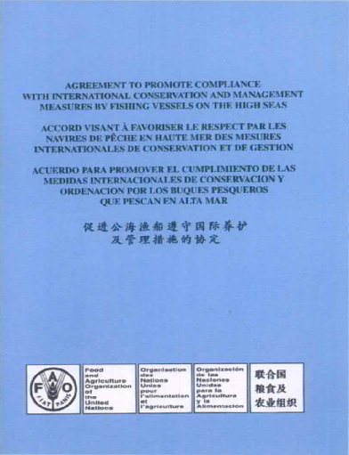
Binding Legal Instruments
REGIONAL INTIATIVES FOR SUSTAINABLE USE OF THE AFRICAN OCEANS AND SEAS | Ndiaga Gueye, FAORAF
UNCLOS
The 1995 United Nations Fish Stock Agreement
The 1993 FAO Compliance Agreement
2009 FAO Agreement on Port State Measures
CBD, CITES, CMS …

Slide 13
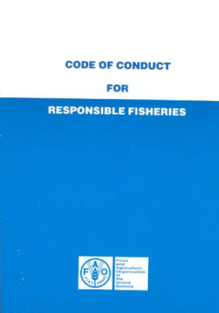
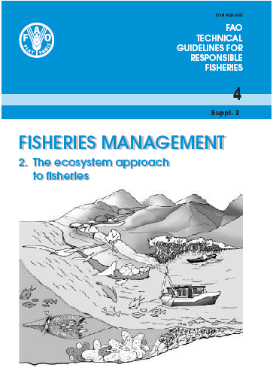
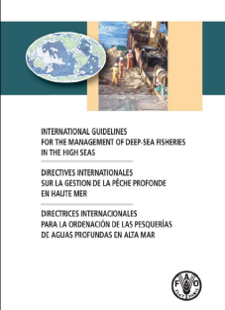
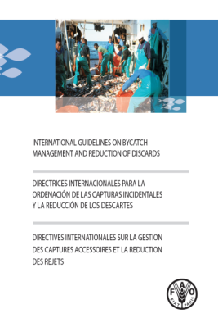
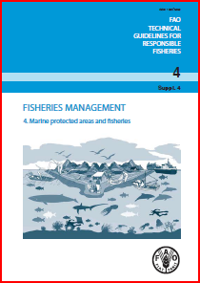
Non-binding instruments
REGIONAL INTIATIVES FOR SUSTAINABLE USE OF THE AFRICAN OCEANS AND SEAS | Ndiaga Gueye, FAORAF
CODE OF CONDUCT FOR RESPONSIBLE FISHERIES
International Plan’s of Action IPOAs
FAO Technical Guidelines
FAO International
Guidelines
Seabirds
Sharks
Capacity
IUU Fishing
UNGA resolutions, CBD guidelines, etc.

Slide 14
Origin and role of regional fisheries bodies and management organizations (RFBs & RFMOs)
According to International Law:
State’s freedom to sail fishing vessels flying their flag on the high seas is limited to some conditions:
Flag States have primary responsibility for controlling the fishing activities of their vessels both within their EEZs and on the high seas
Flag and coastal States have the duty to cooperate so as to ensure fisheries sustainability and stocks conservation
UNCLOS invites States to create such organizations where they do not exist
The main mechanism for organizing this cooperative management is through international bodies such as RFMOs
KMI International Seminar on Regional Cooperation for Fisheries Management in the Northwest Pacific Ocean

Slide 15
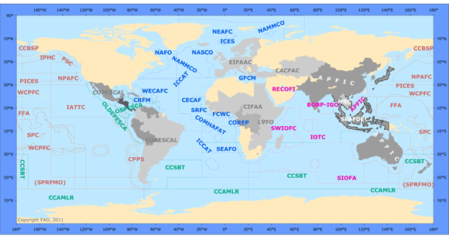
RFBs/RFMOs Net(work?)
RFBs/RFMOs Net(work?)
RAAFO

Slide 16
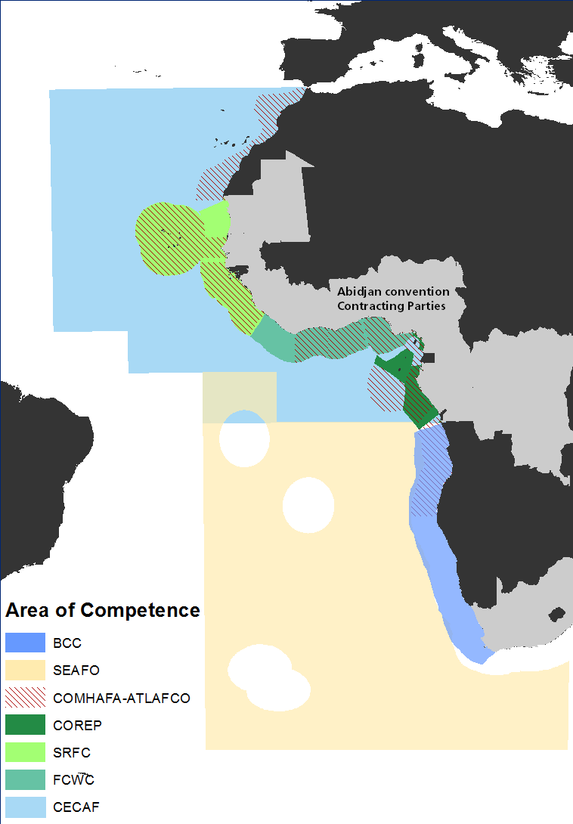
Regional Institutional Context
REGIONAL INTIATIVES FOR SUSTAINABLE USE OF THE AFRICAN OCEANS AND SEAS | Ndiaga Gueye, FAORAF
Many RFBs & RFMOs
Range of mandates
CECAF, SFRC, FCWC, COREP, SEFAO
SWIOFC,IOTC,COMAPHAT
Abidjan Convention
Benguela Current Commision
Canary Current Large Marine Ecosystem

Slide 17
Other organisations
COMHAFAT/ ATLAFCO: | Namibia to Morocco, 14 coastal state members and 8 associated members | Regional cooperation on fisheries development; coordination and harmonization of efforts and capacities of stakeholders for the conservation and exploitation of fisheries resources.
SRFC: | Members' territorial waters and Exclusive Economic Zones, Northwest Africa, 7 coastal country members | Cooperation between Member States, coordination of policies: the conservation and exploitation of fisheries resources in the sub-region; Adoption of international best practices; Sub-regional cooperation with regard to MSC; Development of Members' research capacities in fisheries sciences
FCWC: | Territorial seas and EEZs of member states, Western Gulf of Guinea, 6 coastal country members | Cooperation among its Member States to ensuring, through appropriate management, the conservation and optimum utilization of the living marine resources, and encouraging sustainable development of fisheries
COREP: | Marine and Inland waters, Fisheries and Aquaculture, Gulf of Guinea, 5 coastal country members+ 2 observers | Harmonisation of policy and regulations for conditions of fishing and the control of fishing operations; preserve and protect aquatic ecosystems, Stock assessment shared stocks; Scientific data collection and analysis; fishing and aquaculture technology
SEAFO: | ABNJ, Southeast Atlantic | Ensure the long-term conservation and sustainable use of the fishery resources in SEAFO’s area of competence
ICCAT: | Waters of the Atlantic Ocean, inc. adjacent seas; 60 members | Conservation of tunas and tuna-like species in the Atlantic Ocean and adjacent seas
Notes:
Brief overview of objectives and areas of work of the other organisations: Shows Coverage, members and Objectives/main areas of work; Mention that both ICCAT and SEAFO are RFMOs that take decisions that are bidning on their members
Souligner de facons generale ce qu’elles font notament dans le cadre de la gestion des peches et donc de conservation de la biodiversite
Cooperating Non-Contracting Party (COMHAFAT)- Ministerial Conference on Fisheries Cooperation Among African States Bordering the Atlantic

Slide 18
Challenges
REGIONAL INTIATIVES FOR SUSTAINABLE USE OF THE AFRICAN OCEANS AND SEAS | Ndiaga Gueye, FAORAF
Misunderstanding of respective roles and mandates
Mismatch of programming cycle
Insufficient interactions and coordination
Lack of opportunities for feedback
Internal processes and capacity of regional organizations
18

Slide 19

Key Fisheries Management Issues
REGIONAL INTIATIVES FOR SUSTAINABLE USE OF THE AFRICAN OCEANS AND SEAS | Ndiaga Gueye, FAORAF
Overexploitation
On habitats (from fishing/fishing related activity, bycatch impacts ties/externals)
Livelihoods/dependence on fisheries/fishers/fisher communities
Trade/big business
Weak management/How to implement EAF?/Develop appropriate management tools
Shared stocks
Poor Data in the region (not all parts!)
Reporting issues
Climate variability and change
Lack of good governance
IUU

Slide 20
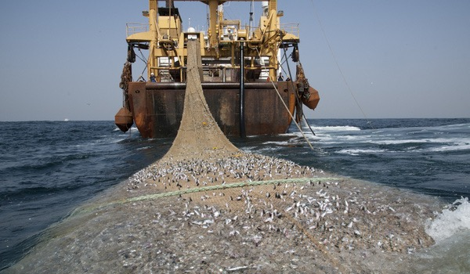
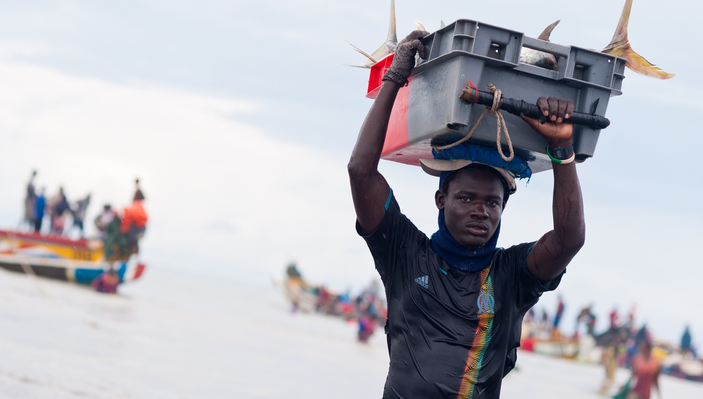
IUU Fishing in the Africa Region
REGIONAL INTIATIVES FOR SUSTAINABLE USE OF THE AFRICAN OCEANS AND SEAS | Ndiaga Gueye, FAORAF
Along the coast of Africa, IUU fishing takes various forms:
  surveillance avoidance,
  transshipment,
  abuses of vessel registries,
  licensing abuses,
  interactions with artisanal vessels and sister ships
africaprogresspanel.org
  the implementation of non-compliant fishing gear and fishing without a license
  industrial level, IUU fishing is mostly conducted by foreign vessels fishing without a fishing license
  engaging in illegal transshipment activities in national waters and on the high seas
  not reporting the catches made/making false statements and operating in fishing zones reserved for the artisanal segment.
africaprogresspanel.org
20

Slide 21



Persistent Challenges to Combat IUU fishing
REGIONAL INTIATIVES FOR SUSTAINABLE USE OF THE AFRICAN OCEANS AND SEAS | Ndiaga Gueye, FAORAF
There are several political, legal, institutional, educational and operational challenges to be addressed in the fight against IUU fishing, including:
Strengthening of legal and governance frameworks at national, regional and global levels
Enhancing the capacity of developing States to manage, monitor and control fishing activities
Developing globally accepted standards for market access, trade and traceability

Slide 22



Suggested Recommendations
Enhance legislation
Work with international organizations and RFB/RFMOs to enhance fisheries legislations and ensure legislation is in line with existing international instruments to combat IUU fishing
Implement international instruments for fisheries management and IUU
PSMA, Voluntary Guidelines on Flag State Performance, IPOA-IUU (national and regional level), MCS, 1993 Compliance Agreement
Reinforce regional cooperation and coordination
• National and regional level, national law enforcement agencies, fisheries authorities, coast guards, customs, port authorities
• Coordinate with FCWC, COREP, COMHAFAT/ATLAFCO, SRFC, ICCAT, INTERPOL, Fish-i Africa, Stop Illegal Fishing, EU, State and non-State actors
• Establish regional arrangement for implementation of PSMA, MCS and other instruments to combat IUU fishing
• Enhance effectiveness of and strengthen RFMOs/RFBs for fisheries management, implementation of instruments and enforcement of regulations

Slide 23

Take Home Message
Governments to sign on the Port State Measures Agreement and to consider taking immediate action to implement the treaty.

Slide 24

Thank You
Ndiaga Gueye
ndiaga.gueye@fao.org

