Slide 1
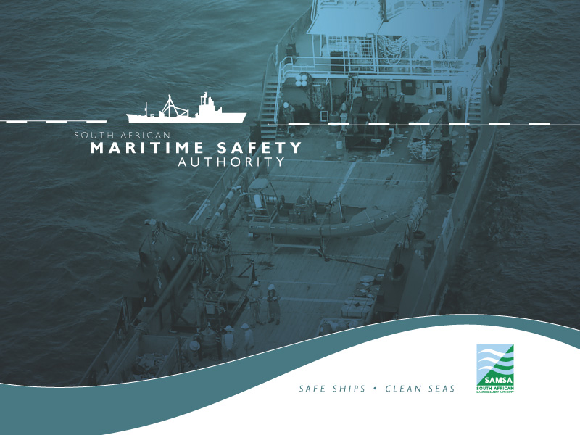
South African Cadetship Programme

Slide 2
Introduction
South Africa has a skills crisis that mirrors global conditions and the mismatch between the available pool of employees and market demands that have been linked to a number of factors, chief amongst those being the state of the education system.
One of the key challenges that the country faced was a shortage of both sea and shore based human resources (South Africans) required to support the maritime industry.
The country relied on foreign expatriates to provide the essential services that the shipping industry required both in Port and at Sea.
South African government through South African Maritime Safety Authority (SAMSA) developed a strategy to grow and develop the country’s maritime economy.
The National Development Plan (NDP) concurs that Skills development is linked to economic growth - the Vision 2030 document highlights that the key to sustainable employment and economic growth in South Africa is through education and skills development.

Slide 3
Global View - Seafarer Supply Countries
Estimated 5 largest seafarer supply countries
 | For all Seafarers | For Officers | For Ratings
1 | China | China | Phillipines
2 | Phillipines | Phillipines | China
3 | Indonesia | India | Indonesia
4 | Russian Federation | Indonesia | Russian Federation
5 | Ukraine | Russian Federation | Ukraine
 |  |  | Source: BIMCO,2015

Slide 4
Global Supply and Demand for Officers

Slide 5
Seafarer Challenge
According to the BIMCO report of 2015, The worldwide population of seafarers serving on internationally trading merchant ships is estimated at 1,647,500 seafarers, of which 774,000 are officers and 873,500 are ratings.
Some Officer categories are in especially short supply, including engineer officers at management level and officers needed for specialised ships such as chemical, LNG and LPG carriers.
The report suggests that in the past five years the industry has made good progress with increasing recruitment and training levels and reducing officer wastage (i.e. retaining qualified seafarers and increasing the number of years which they serve at sea).
But the report indicates that, unless training levels are increased significantly, the growth in demand for seafarers could generate a serious shortage in the total supply of officers.

Slide 6
SAMSA Mandate & Objectives
    SAMSA is a regulatory entity mandated to administer the maritime laws for the South African government.
    This is undertaken in consideration of the following objectives:
    Ensuring the safety of life and property at sea
    Preventing and combatting marine environment pollution by ships
    Promoting the maritime interests of the Republic

Slide 7
The South African Challenge
Around 2008, SAMSA was looking at providing sea-time for its surveyors who did not have a requisite certificates of competence ( Class 1 Engine & Deck)
Many South African graduates with an S2 qualification were looking for Cadetship Opportunities ( Deck and Engine Discipline)
Transnet ( NPA) had started a programme aimed at addressing the skills shortage impacting on the efficiency of their port services
In 2010, SAMSA started the Programme to address the challenge of ensuring that Black South Africans do actively participate in the maritime affairs of the country.
At the same time, this programme was aimed at addressing the ageing maritime workforce
South African Flagged ships were significantly reduced post democratic government
The awareness and interest of maritime as an industry rose significantly as a result of SAMSA leadership

Slide 8
National Cadetship Programme ( NCP)
The National Cadetship Programme was launched in 2011. It offers practical training and sea-time experience with international shipping lines, enabling maritime students to obtain internationally-recognised STCW (Standards of Training, Certification, and Watch-keeping) qualifications and become globally sought-after seafarers.
The concept of the NCP was essentially to provide practical training (cadetship) to all aspirant officers who had completed their theoretical training.
The main motivation was the fact that there was a growing number of berths awaiting cadets coming out of training institutions that were starting to contribute to unemployment, some waiting up to seven years to get berths and consequently some training institutions such as CPUT threatening to close down their seafarer training programme.
SAMSA took a leading role of gathering and engaging various organisations to partner as hosting employment companies for South African Cadets.

Slide 9
Role Players
University of Technologies
Service Providers for managing training of Cadets
Shipping Companies for hosting cadets
Department of Higher Education for Funding
Maritime Employers

Slide 10
Beneficiaries
As a result of the shortage of Marine Engineering graduates, we also initiated a conversion programme whereby we recruited 64 Mechanical Engineering graduates for this purpose
Over 531 young South Africans have benefitted since the inception of the NCP

Slide 11
NATIONAL CADETSHIP PROGRAMME ( Current)
NCP DEMOGRAPHICS
 | Male | Female | Total in Training
Black | 99 | 13 | 78%
Coloured | 14 | 2 | 11%
Indian | 5 | 0 | 3%
White | 11 | 0 | 8%
TOTAL Cadets | 129 | 15 | 144
TOTAL Black | 92%
TOTAL White | 8%

Slide 12
TNPA Current Cadetship Programme
 |  | Gender |  | Race
Type of training (maritime related) | No of beneficiaries | Male | Female | Black | White
Cadet Programme
Marine Deck Cadets for Tugmaster Qualification | 58 | 37 | 21 | 57 | 1
Marine Deck Officers for Chief Mate Qualification | 25 | 11 | 14 | 24 | 1
Marine Engineering Cadets for MEO Qualification | 59 | 44 | 15 | 59 | 0
Marine Engineering Officers for 2nd Engineer Qualification | 33 | 26 | 7 | 33 | 0

Slide 13
SA Agulhas
A Dedicated Training & Research Vessel
Able to carry approximately 80 cadets per voyage, depending on voyage type & exhibition
Normally used to provide 3-4 Months sea experience
Currently owned by SAMSA
On-board Training funded by the National Skills Fund ( Department of Higher Education)

Slide 14
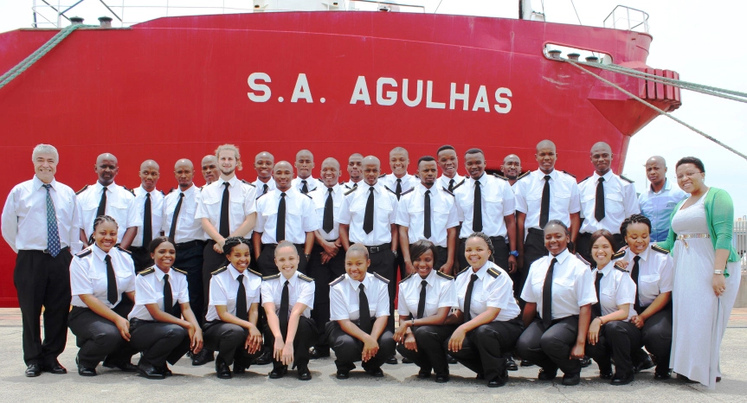
SA Agulhas

Slide 15
Training on Board SA Agulhas
Training on-board the vessel is in lecture format and practical engagement
It encompass Seamanship, Navigation, Bridge Watch and Deck Maintenance
Those who successfully complete the training programme on board will need to complete further sea time on board trading vessels towards the STCW minimum requirement of 12 months.
Thereafter, and upon completion of all statutory safety and ancillary courses, they can sit for their oral exams which are administered by SAMSA

Slide 16
Other contributions of the Agulhas
SAMSA got a contract with the Commonwealth celebrating the Queen’s Diamond Jubilee by staging an expedition to the Antartica on-board the Agulhas. This also provided an opportunity for our cadets to get their on-board training.
The voyage was positioned to not only service the Commonwealth contract but to also to extend the benefits beyond the borders of the Republic into the African continent.
A Pan-African approach was adopted with the Agulhas having stop over in the Ports of Tema in Ghana and in Cote d’Ivoire to collect 10 cadets of the partnering maritime administration
The Chartering Agreement that we have with the Indian government, also provides an opportunity for training cadets and allowing the country to partner and participate in research expeditions for the benefit of the globe
Together with other government fleets, Agulhas is used to provide work experience to recently qualified officers who are still seeking employment

Slide 17
Certification
A Certificate of Competency ( CoC) is then issued in line with STCW Convention.
The quality is approved and audited by IMO with South Africa being on the White List (Grading) of the IMO.
SAMSA is the custodian of the SA Register of Seafarers, accounting for number of seafarers, the validity of their certificates as well as the status of employment* (not required by legislation but rather monitoring employment activity of seafarers)

Slide 18
Innovative Approaches
Innovative approaches to seafarer training, which have the potential for replication if successful, are being followed with two international shipping companies
Klaveness Shipping recruits a small number of cadets into an intensive programme aimed at developing their own future officer corps from cadet to apprentice to fully-fledged officer, as opposed to simply providing training berths and signing cadets off after sea service;
South African International Maritime Institute ( SAIMI) has overseen the modification of two MACS Shipping Line vessels to accommodate up to 10 cadets each, with an on-site training officer, in a model that enables a trading vessel to double-up as a training vessel

Slide 19
Way-forward
Grow SA ship register
Partnerships and Collaborative efforts
Increase and inculcate maritime culture
Increase the country’s training capabilities
Continual Seafarer development

Slide 20
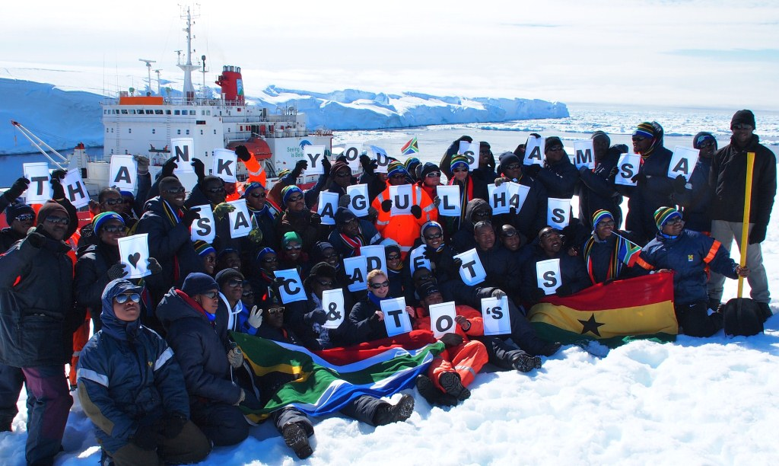
Beneficiaries
As part of the NCP, we launched a programme to recruit and train Mechanical Engineering graduates and converting them to Marine Engineers.
We also hosted African Cadets on an Agulhas Voyage to Antarctica
Since 2012, a total of 531 South African youth have benefitted from the programme
These beneficiaries, are employed within the industry
Others have sought to further their studies

